Slide 1




NEXT GEN EMPLOYABILITY PROGRAM
Creating a future-ready workforce
Team Members
College Name
Student Name :S.R.SINJU
Student ID : au960221243044
Arunachala college of engineering for women

Slide 2

CAPSTONE PROJECT SHOWCASE
Project Title
Car Rentals Application with Django Framework
Abstract | Problem Statement | Project Overview | Proposed Solution | Technology Used | Modelling & Results | Conclusion

Slide 3
Abstract
The advancement of technology has revolutionized various industries, including the transportation sector. Car rental businesses are no exception, where the efficient management of vehicles, bookings, and customer information is crucial for success. This project proposes the development of a comprehensive car rental application using the Django framework, a high-level Python web framework known for its simplicity and scalability.
The proposed system aims to streamline the process of managing car rentals for both customers and administrators. Customers will have access to an intuitive user interface where they can browse available vehicles, make reservations, view rental history, and manage their profiles. On the other hand, administrators will have full control over the system, allowing them to add new vehicles, manage bookings, track payments, and generate reports.
Source :

Slide 4
Problem Statement
Car rental businesses face operational inefficiencies:
Manual booking processes lead to errors and delays.
Inadequate vehicle management systems result in underutilization and increased costs.
Disjointed customer interaction platforms cause communication inconsistencies.
Source :

Slide 5
Project Overview
Objective:
Modernize and optimize car rental operations through a Django-based application.
Key Features:
User Authentication & Authorization.
Vehicle Management.
Booking System.
Payment Integration.
Rental History & Profile Management.
Reporting & Analytics.
Technical Overview:
Built on Django framework.
Utilizes built-in features for efficiency.
Integrates third-party libraries for payment and reporting.
Source :

Slide 6
Proposed Solution
Develop a comprehensive car rental application using Django framework:
Automate booking processes to eliminate errors and delays.
Implement robust vehicle management systems for optimal fleet utilization.
Integrate a centralized platform for seamless customer interaction.
Source :

Slide 7
User Authentication & Authorization: Implement secure login for customers and administrators to access respective functionalities.
Vehicle Management: Create a comprehensive system to add, edit, and manage vehicle listings including availability status.
Booking System: Enable customers to search for available vehicles based on location and date, make reservations, and receive confirmation.
Payment Integration: Integrate payment gateways to facilitate secure online transactions for booking payments.
Rental History & Profile Management: Allow users to view their rental history, manage profiles, and update personal information.
Admin Dashboard: Provide administrators with a dashboard to monitor bookings, manage vehicles, and generate reports.
Source :

Slide 8
Technical Implementation:
Utilize Django's built-in features such as authentication, ORM, and templating for rapid development.
Integrate third-party libraries for payment processing and user interface enhancements.
Ensure scalability and security by following best practices in Django development.
Host the website on a reliable server and implement regular backups and security updates.
Source :

Slide 9


Technology Used
Front-end
Back-end
Source :

Slide 10
Modelling & Results
Modeling:
Define database models for vehicles, bookings, and users using Django's ORM.
Implement booking process, user authentication, and authorization functionalities.
Implementation:
Develop CRUD functionalities for vehicle management.
Integrate secure payment gateways for online transactions.
Ensure responsive design and accessibility for optimal user experience.
Testing and Validation:
Conduct thorough testing to ensure functionality, performance, and security.
Gather feedback from users and stakeholders to refine the website.
Results and Feedback:
Measure key metrics such as booking conversion rates and user engagement.
Iterate based on feedback to continuously improve the website's usability and effectiveness.
Source :

Slide 11
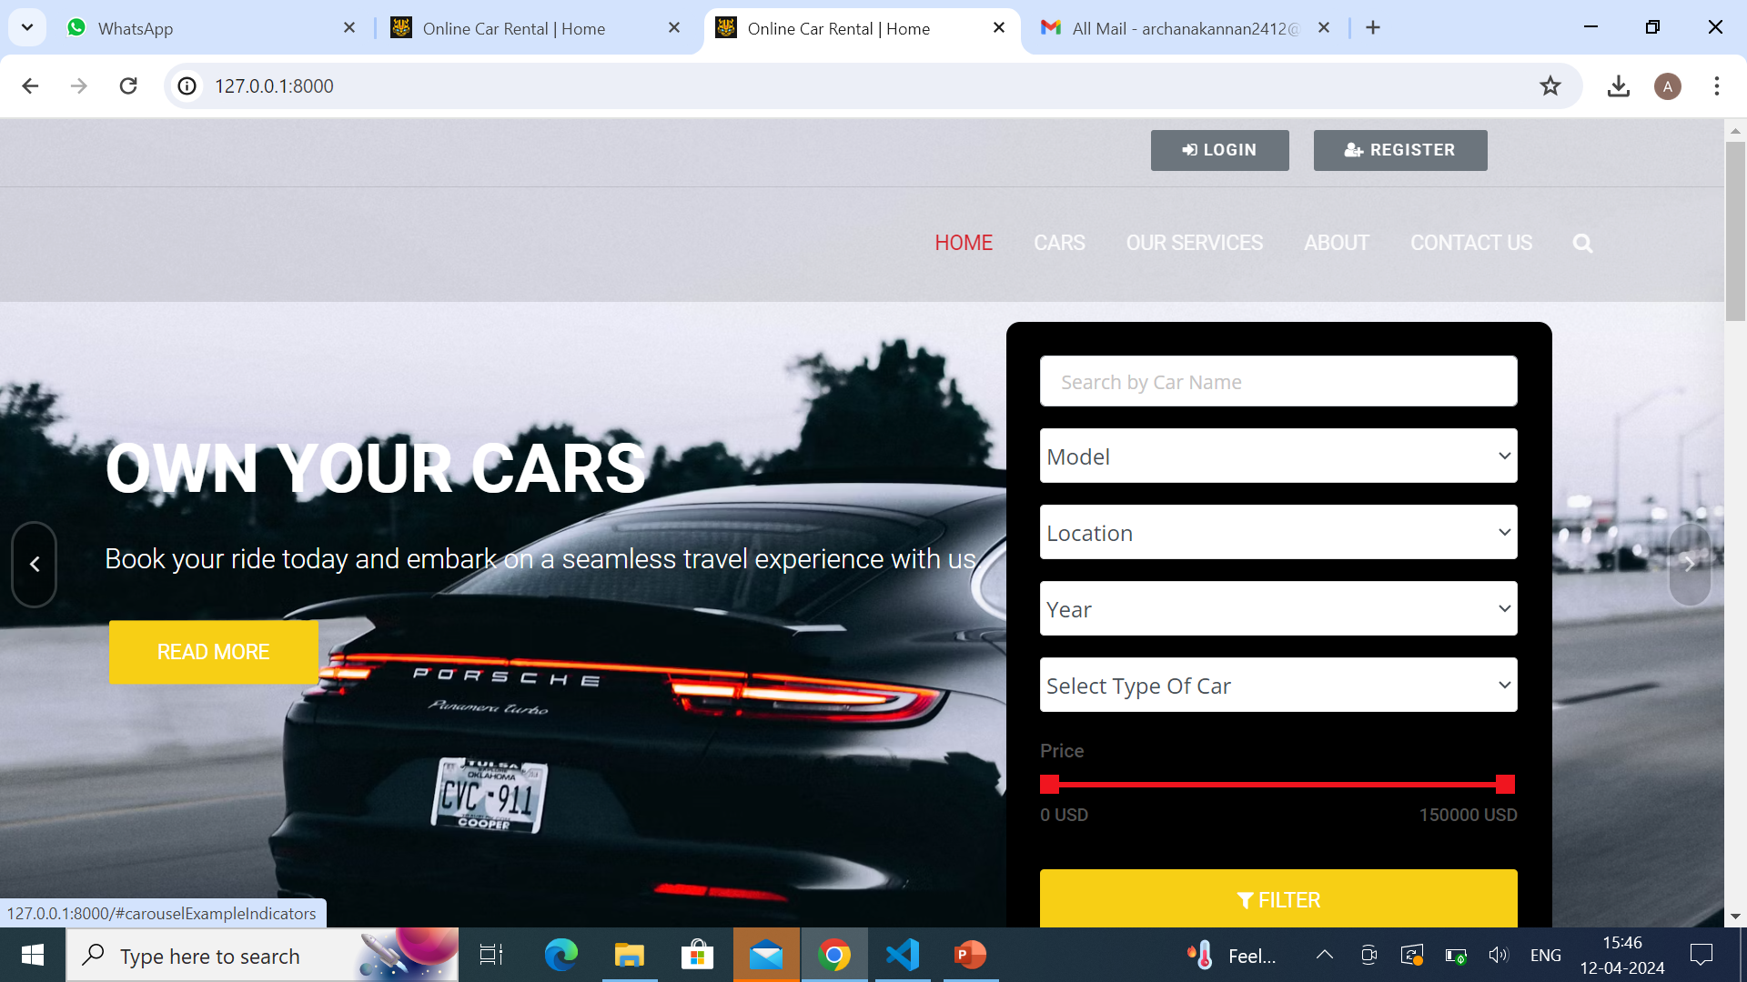
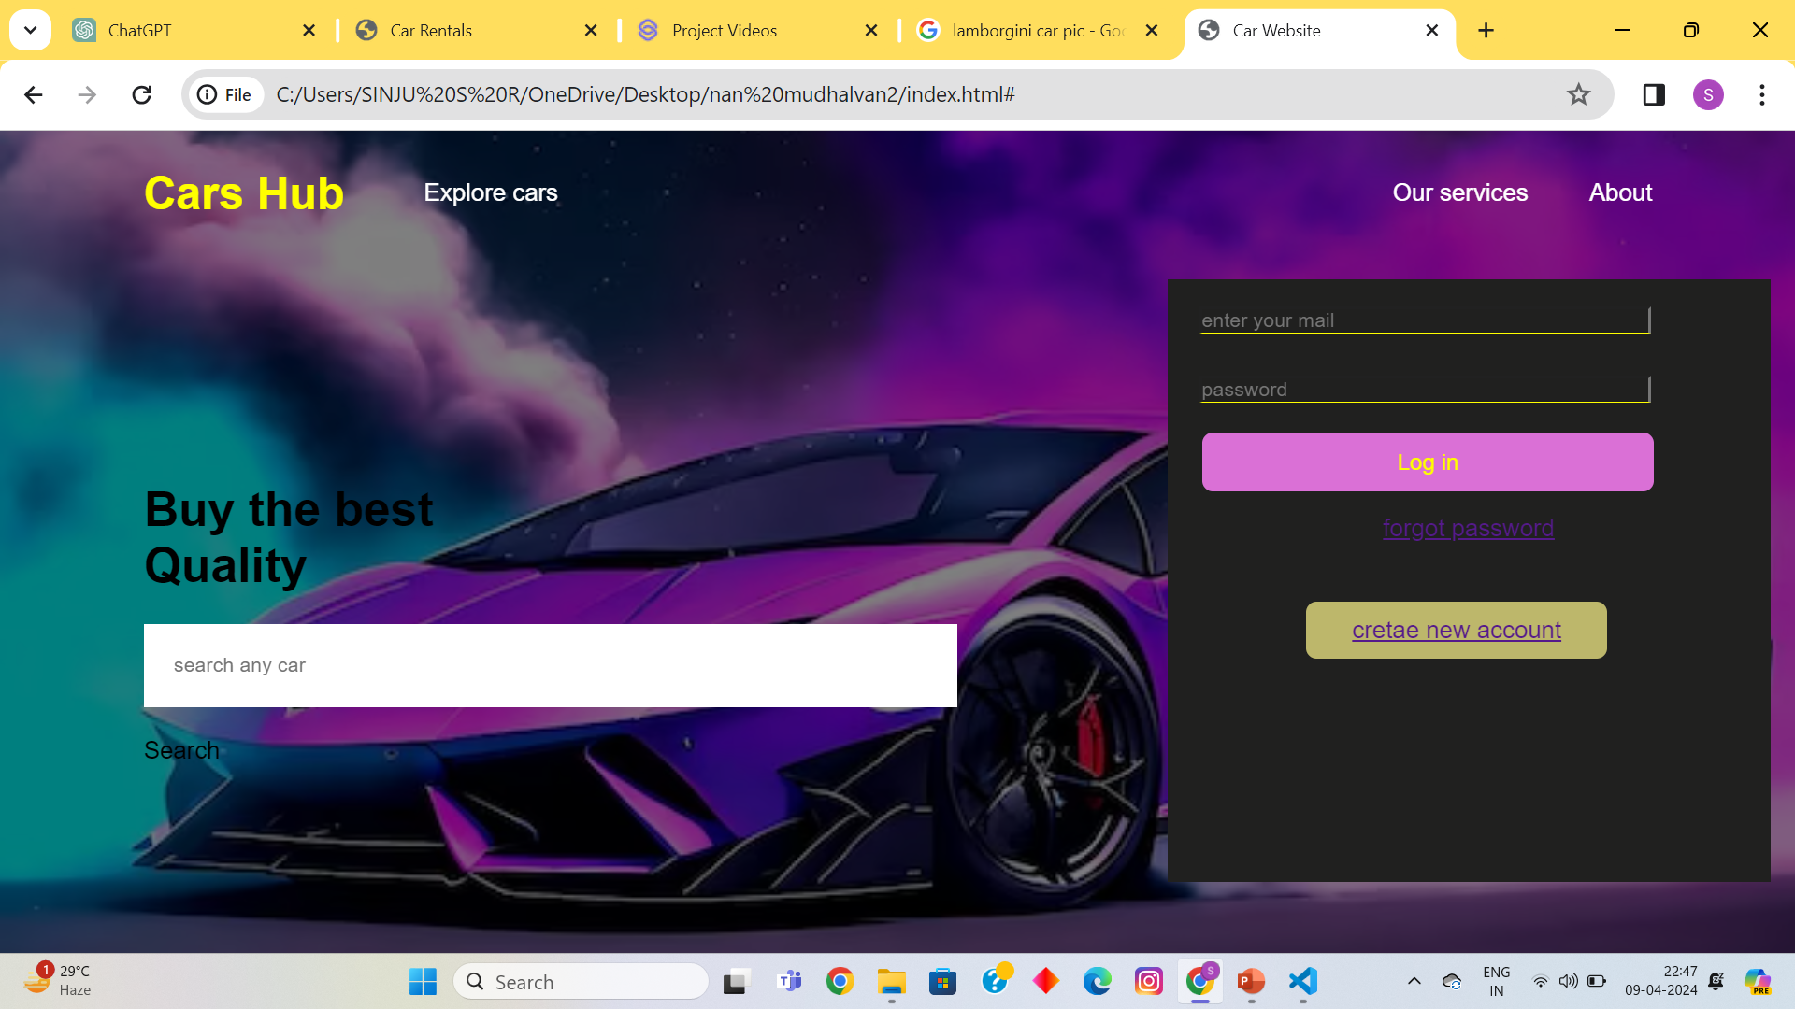
Homepage

Slide 12
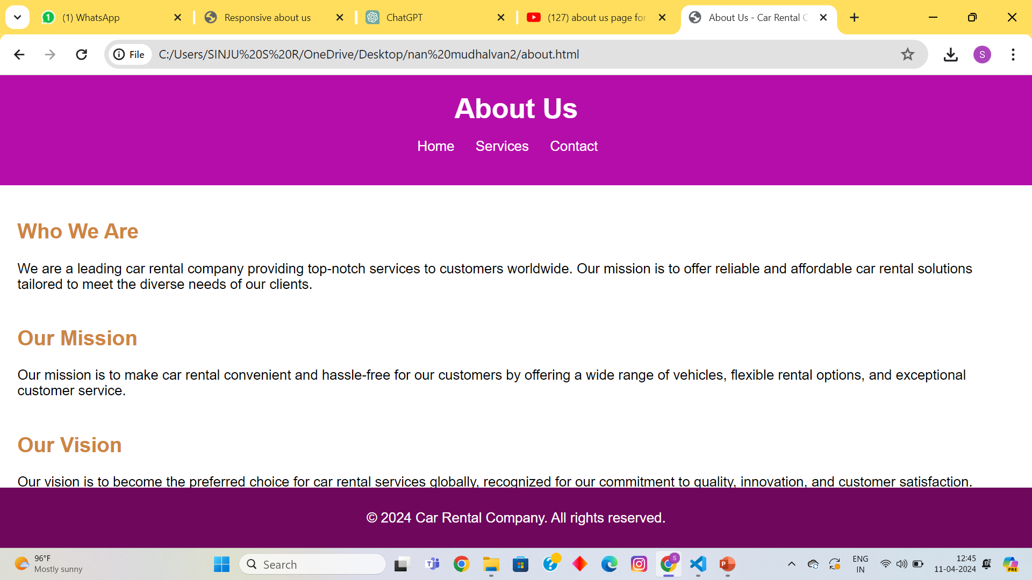
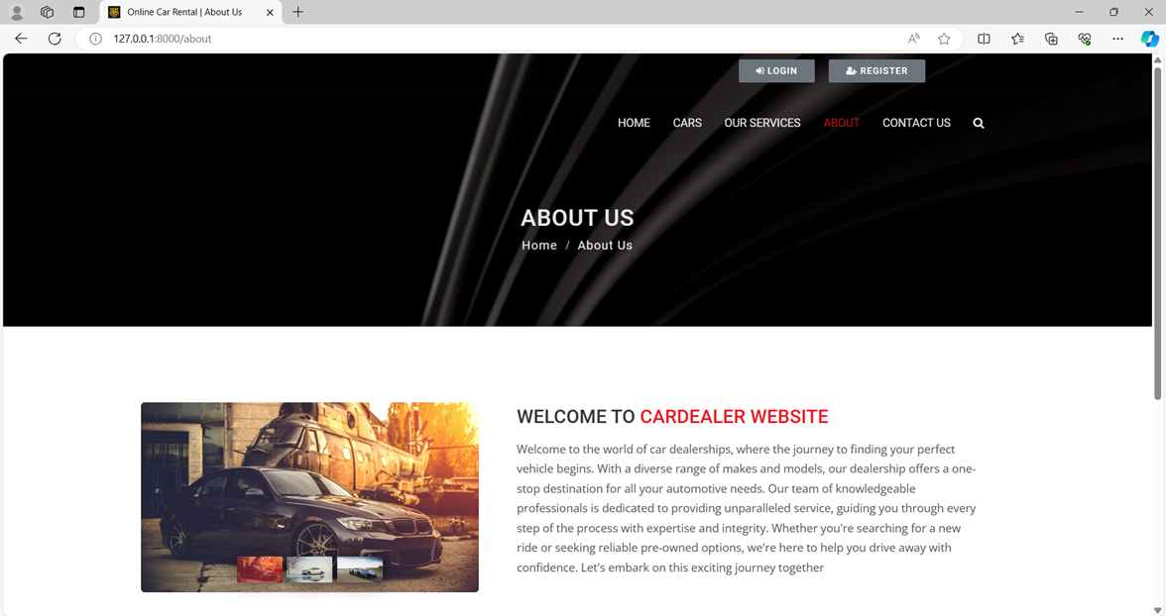
About-Us-Page

Slide 13
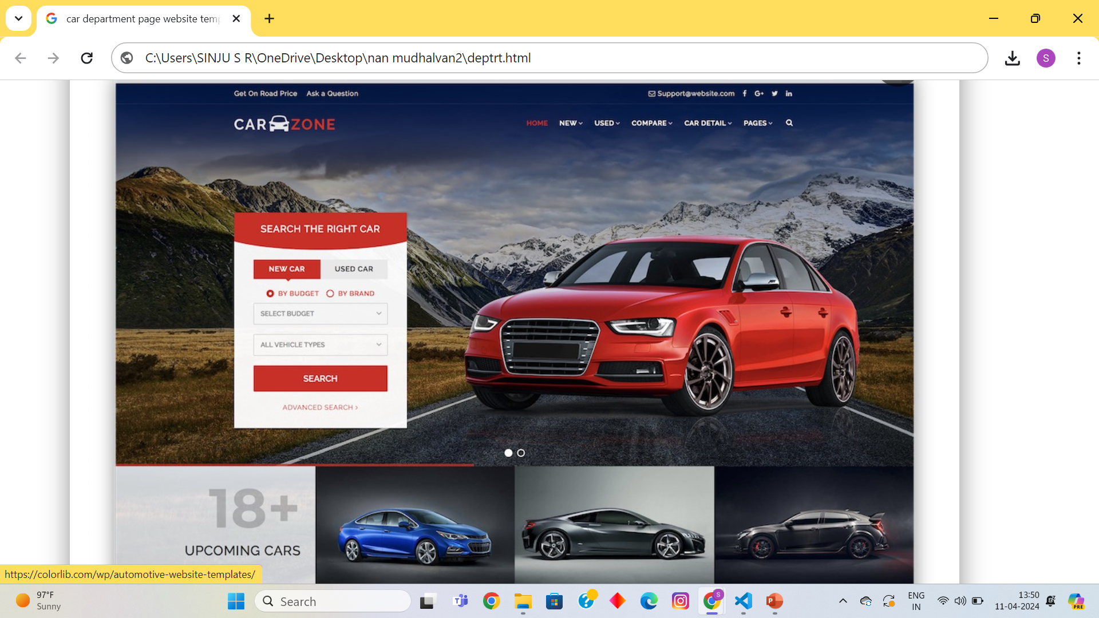
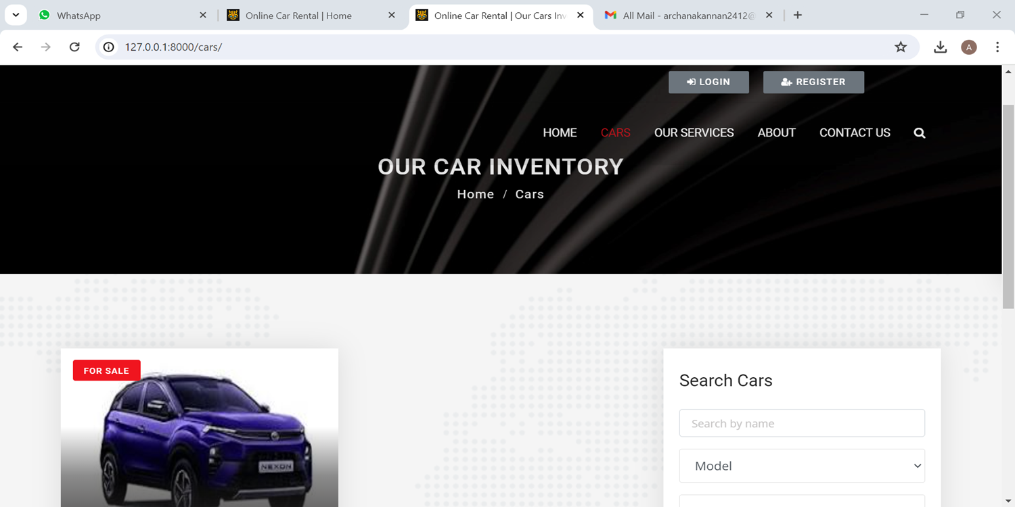
Departments-Page

Slide 14
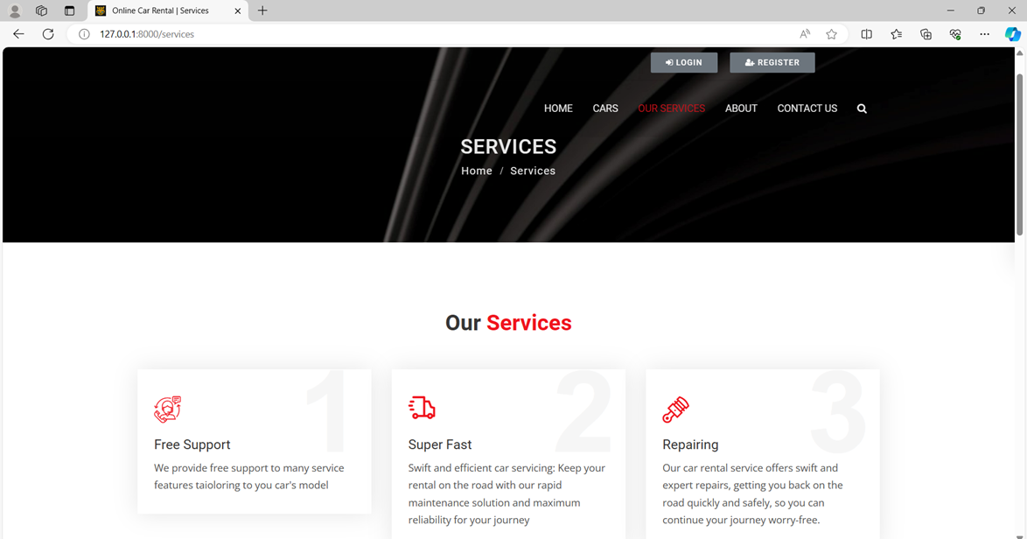
Service-Page

Slide 15
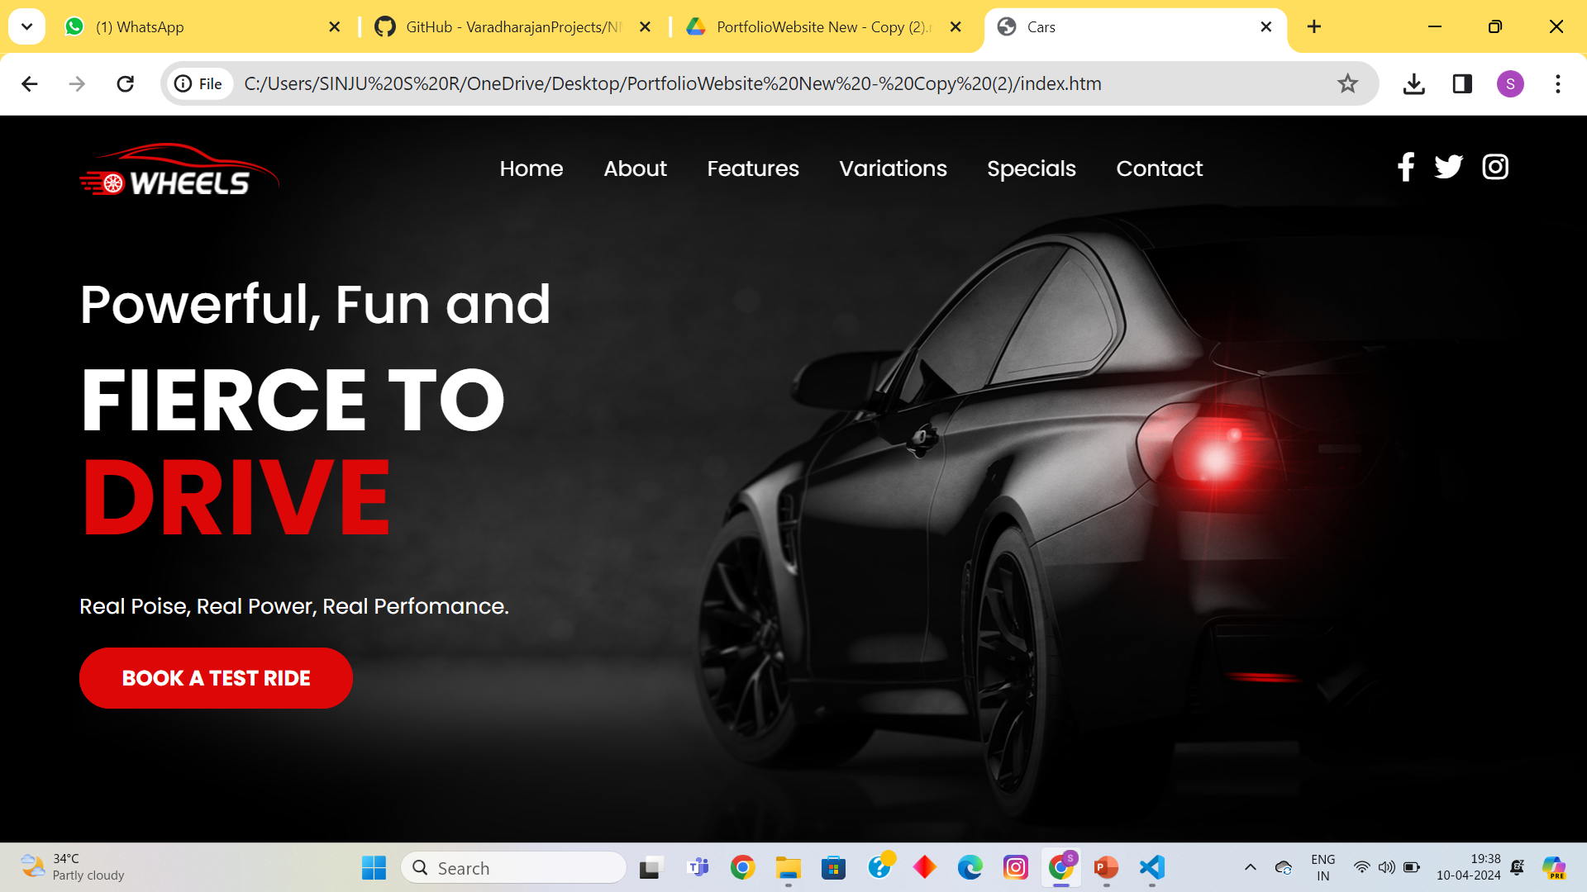
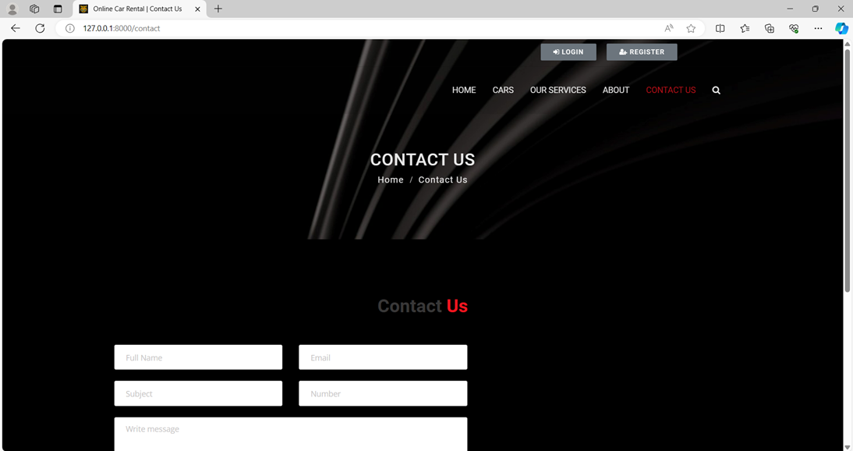
Blog-Page

Slide 16
Future Enhancements:
Dynamic Pricing: Implement dynamic pricing based on factors such as demand, vehicle popularity, and seasonal variations to optimize revenue and encourage booking during off-peak times.
Advanced Search Filters: Enhance the search functionality with advanced filters such as vehicle type, fuel efficiency, and additional features (e.g., GPS, child seats) to help customers find their desired vehicles more efficiently.
Geolocation Integration: Integrate geolocation services to allow customers to search for vehicles based on their current location and provide navigation assistance to rental pickup locations.
Vehicle Tracking: Implement GPS tracking for vehicles to provide real-time location updates to customers and administrators, enhancing security and facilitating efficient fleet management.
Mobile Application: Develop a companion mobile application for iOS and Android platforms to offer on-the-go booking, notifications, and access to rental history, providing a seamless and convenient experience for users.

Slide 17
Conclusion
The proposed car rental website using Django offers a robust solution to streamline operations, enhance customer satisfaction, and drive business growth.
By leveraging Django's features and integrating modern technologies, the website aims to provide a competitive edge in the car rental industry.
Source :

Slide 18
Thank You!
Notes:
Thank You !!

